Slide 1
Amphibians

Slide 2
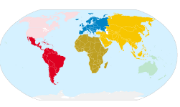
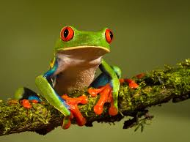
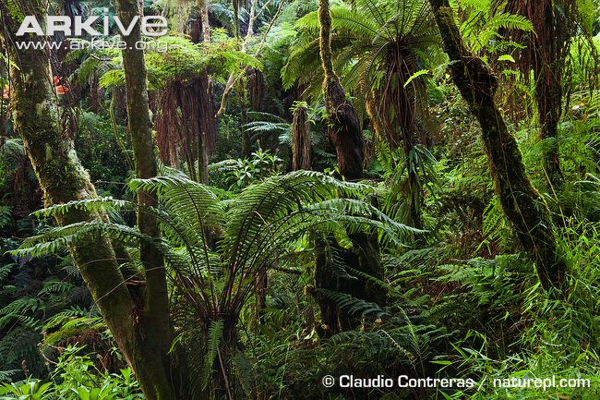
Who am I?
Food
Where in the world?
Worms, insects and bugs.
Group
Habitat
Tree frog
Amphibians

Slide 3
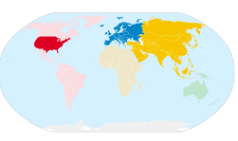
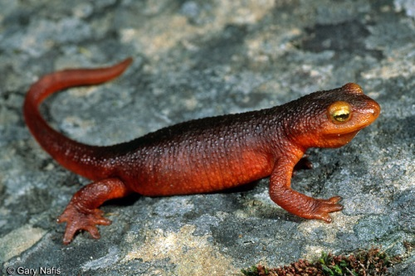
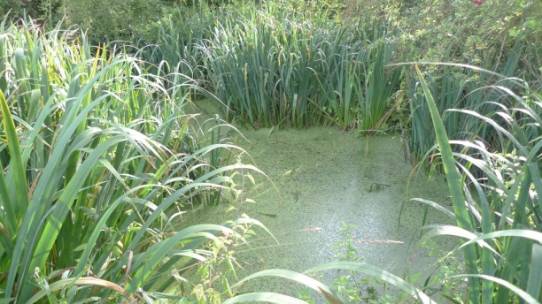
Who am I?
Food
Where in the world?
Worms, insects and bugs.
Group
Habitat
Newt
Amphibians

Slide 4
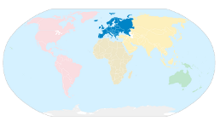
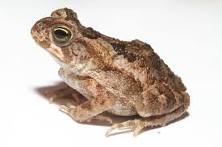
Who am I?
Food
Where in the world?
Worms, insects and bugs.
Group
Habitat
Toad
Amphibians

Slide 5
Invertebrates

Slide 6
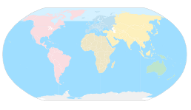
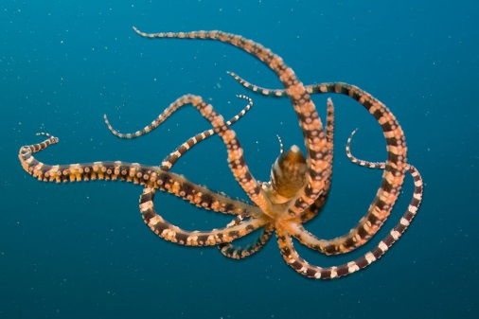
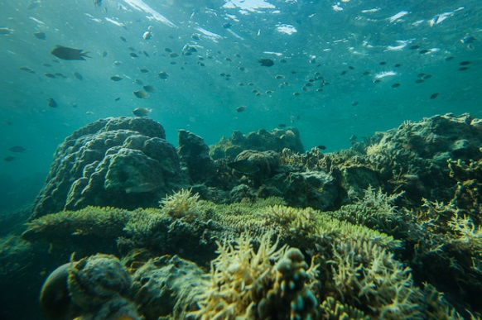
Who am I?
Food
Where in the world?
Crabs and clams
Group
Habitat
Octopus
Invertebrates

Slide 7
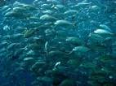
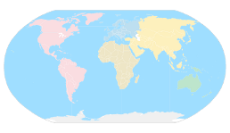
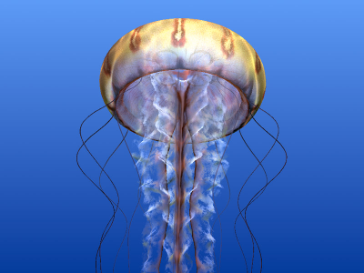
Who am I?
Food
Where in the world?
Fish and fish eggs
Group
Habitat
Jellyfish
Invertebrates

