Slide 1
Fish

Slide 2
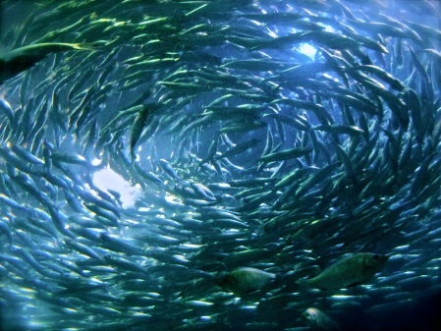
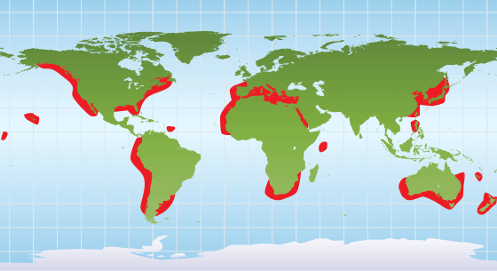
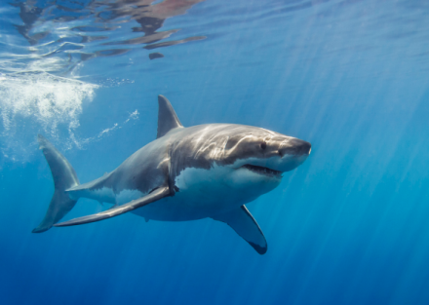
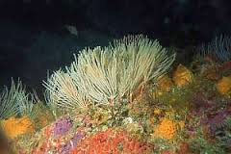
Who am I?
Food
Where in the world?
Fish and other small sea animals
Group
Habitat
Shark
Fish

Slide 3
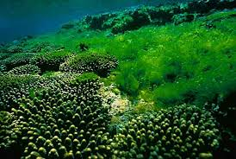
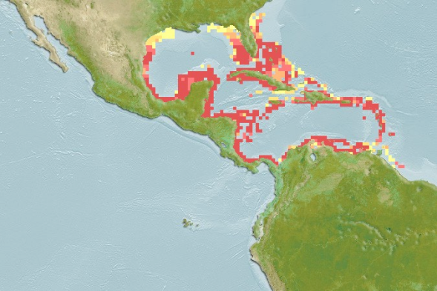
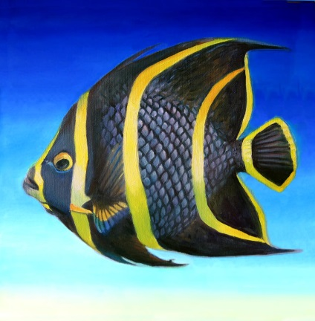
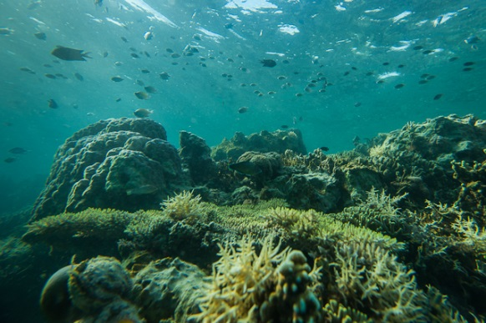
Who am I?
Food
Where in the world?
Algae and sea weed
Angel Fish
Group
Habitat
Fish

Slide 4
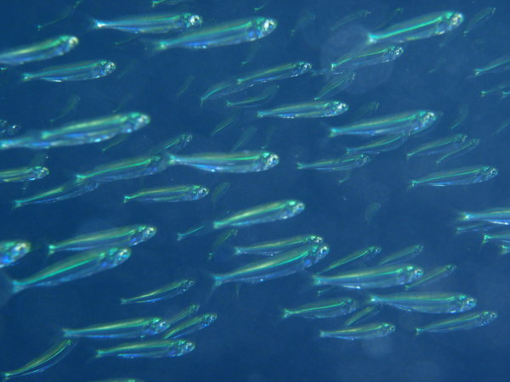
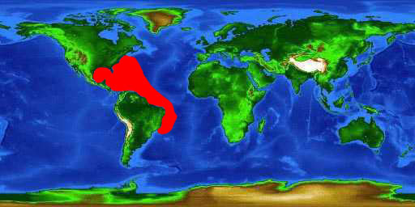
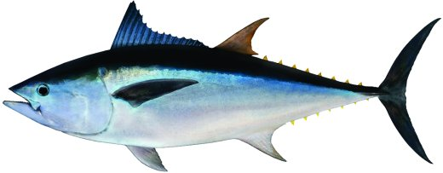
Who am I?
Food
Where in the world?
Small fish
Group
Habitat
Tuna
Fish

Slide 5
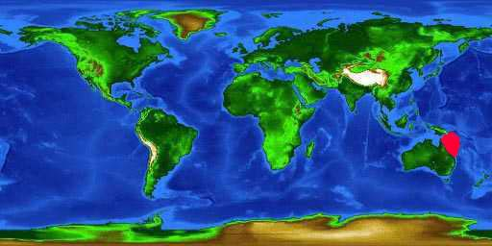
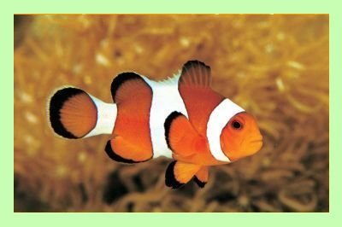
Who am I?
Food
Where in the world?
Algae and sea weed
Clown Fish
Group
Habitat
Fish

Slide 6
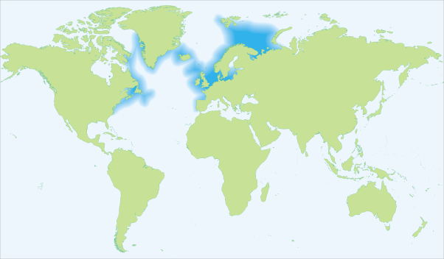
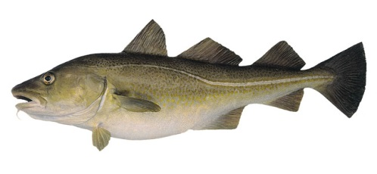
Who am I?
Food
Where in the world?
Small fish and squid
Group
Habitat
Cod
Fish

