Slide 1
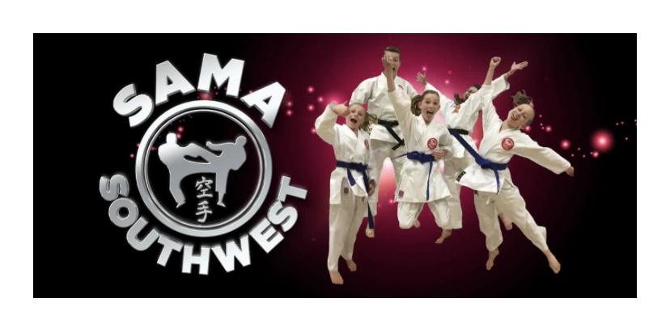
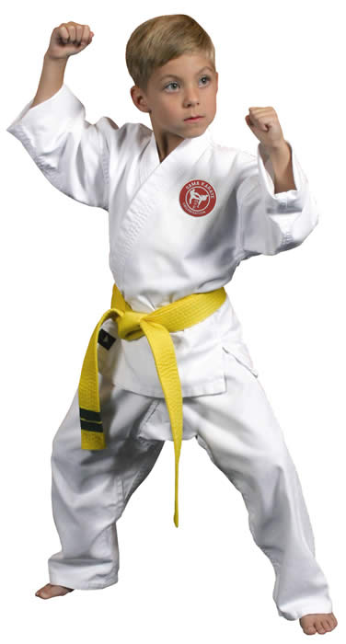
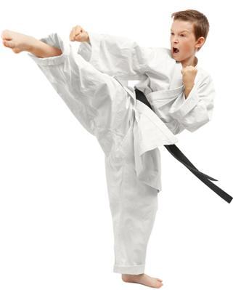
sama karate class – everyone welcome
NON CONTACT KARATE TAUGHT BY FULLY QUALIFIED INSTRUCTORS
JUST TURN UP IN LOOSE COMFORTABLE CLOTHING
Cupernham Juniors School
Every Friday (term time) 07.45 – 08.45
£5.50 PER CLASS – PAY AS YOU GO
Email ms.skoonline@gmail.com to book your place
WE TEACH TRADITIONAL KARATE ENCOURAGING CONFIDENCE, RESPECT, DISCIPLINE, SELF AWARENESS AND AGILITY IN A FUN & CONTROLLED ENVIRONMENT. ALL CLASSES ARE FRIENDLY, INFORMATIVE & CATER TO THE INDIVIDUAL NEEDS OF THE STUDENTS.
T: 07764 478507 www.sama-southwest.com

